Slide 1
Wednesday

Slide 2
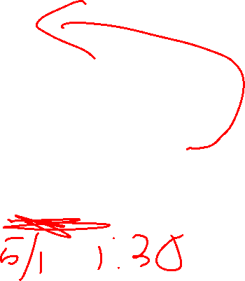
Course Logistics
Exam 2
4/18
Problem Set 5
Due 4/27 (Wednesday the week before finals)
Project Milestone 4
Due Saturday, 4/30 @ 4:30PM – Our Final Exam Slot

Slide 3
Participation – Special Topics Poll
https://forms.gle/u35fTpuzZn7FFtUF7

Slide 4
Exam Logistics
(Same as Exam 1)
On Canvas
50 Minute Timer (+ accommodations)
Support Window (in-person and via Zoom at Lecture Channel)
During Lecture Time (2:30 – 3:20) + extra for accommodations

Slide 5
Exam Expectations
(Same as Exam 1)
Multiple Choice / Matching / Short Answer
Approximately 4 – 5
Calculations / Problem Solving
Approximately 3 to 4
Week 8 (starting with Neural Nets) Through Week 13 (Ethics)

Slide 6
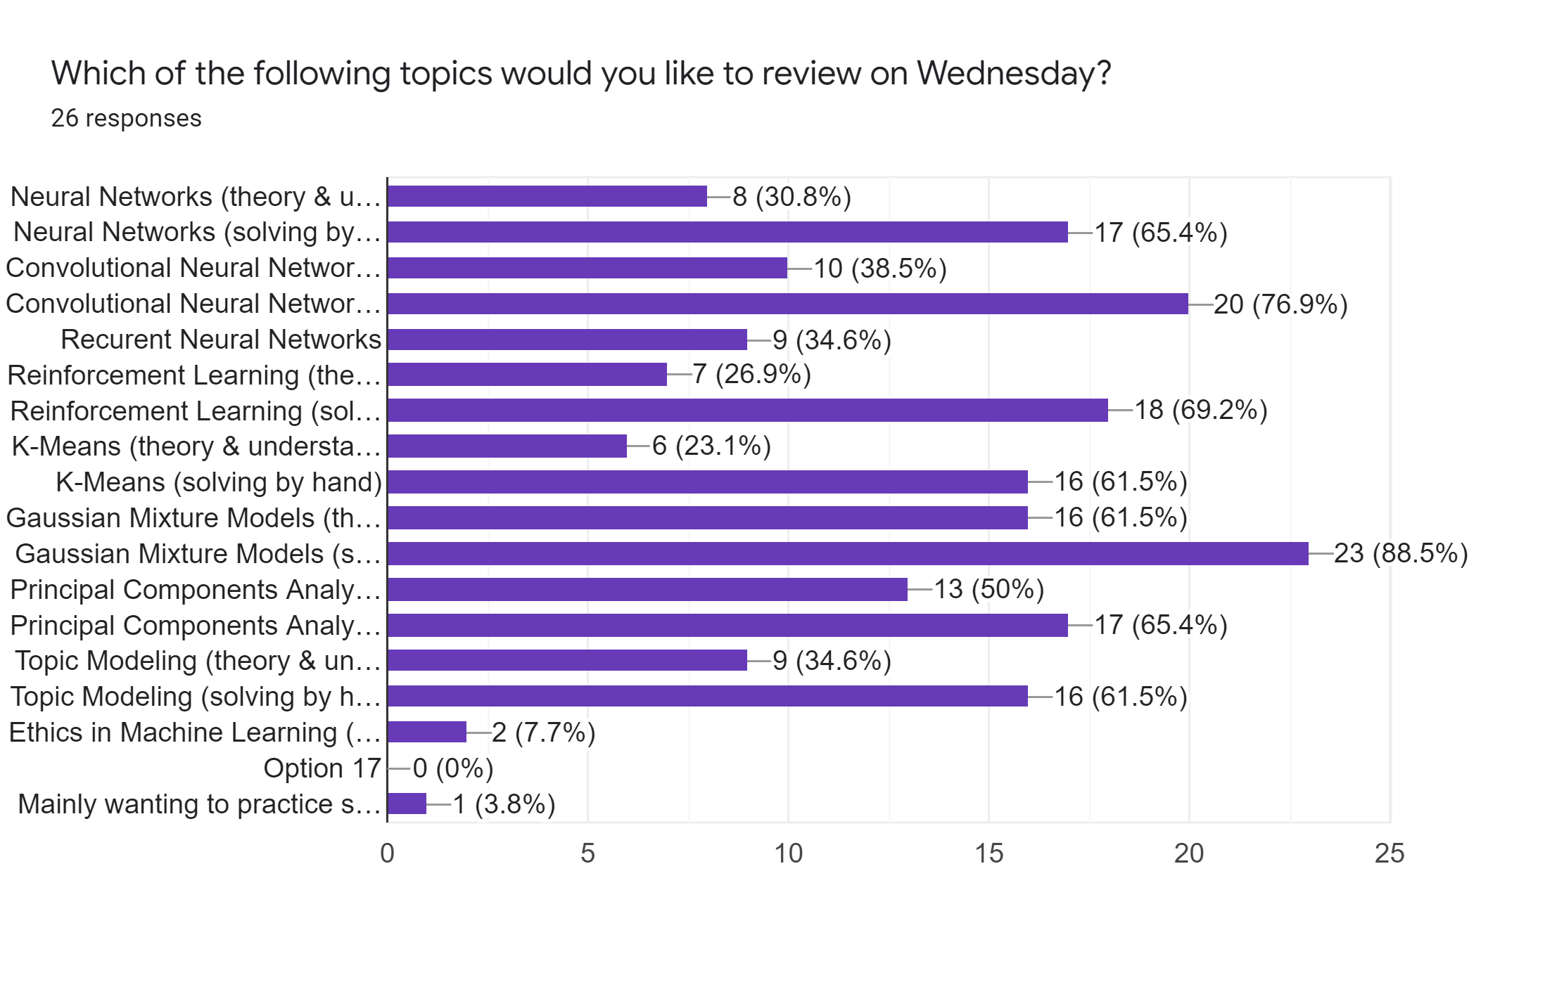


Slide 7
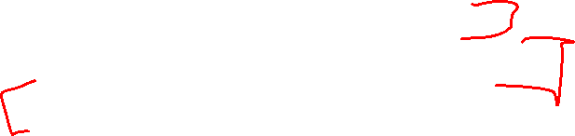
Clustering
Clustering – ground truth X
- No ground truth Y*
- Trying to develop classes from the bottom up
- Trying to build based on hidden structure
Finding clusters such that
- Examples within a cluster are similar
- Examples between clusters are dissimilar
*Ground truth may actually exist, we just a) can’t capture it, or b) are choosing to not use it for our task

Slide 8
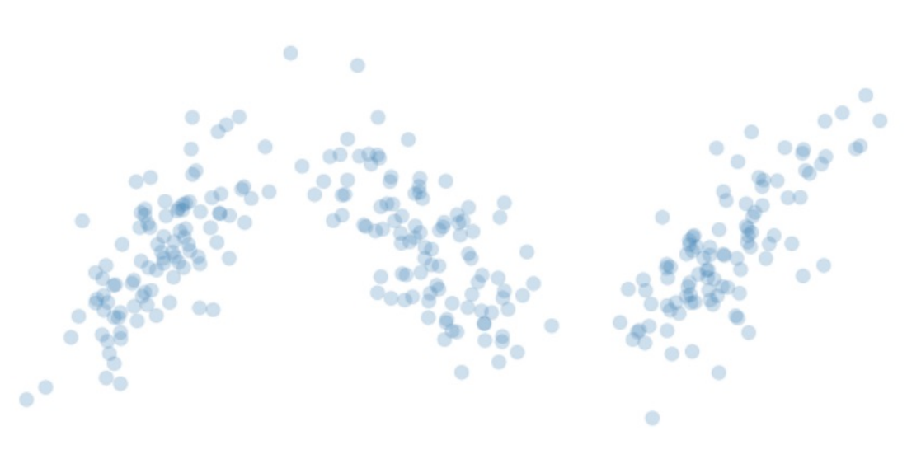
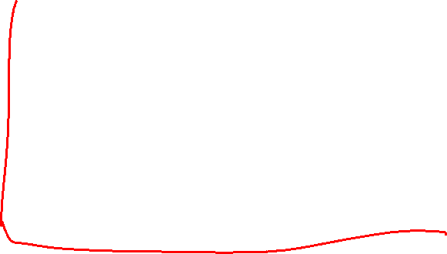
Clustering Objective - Start

Slide 9
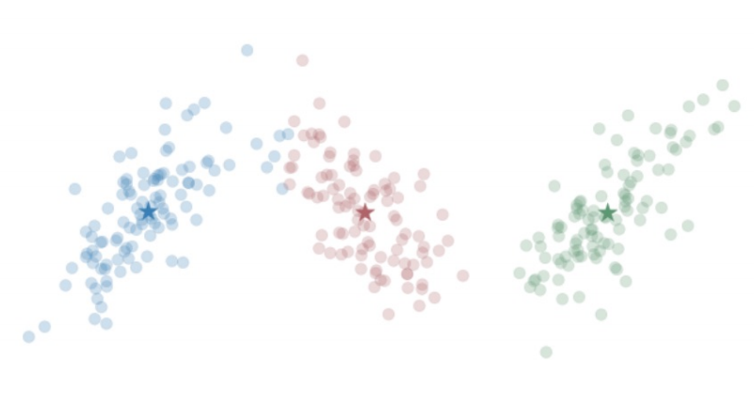
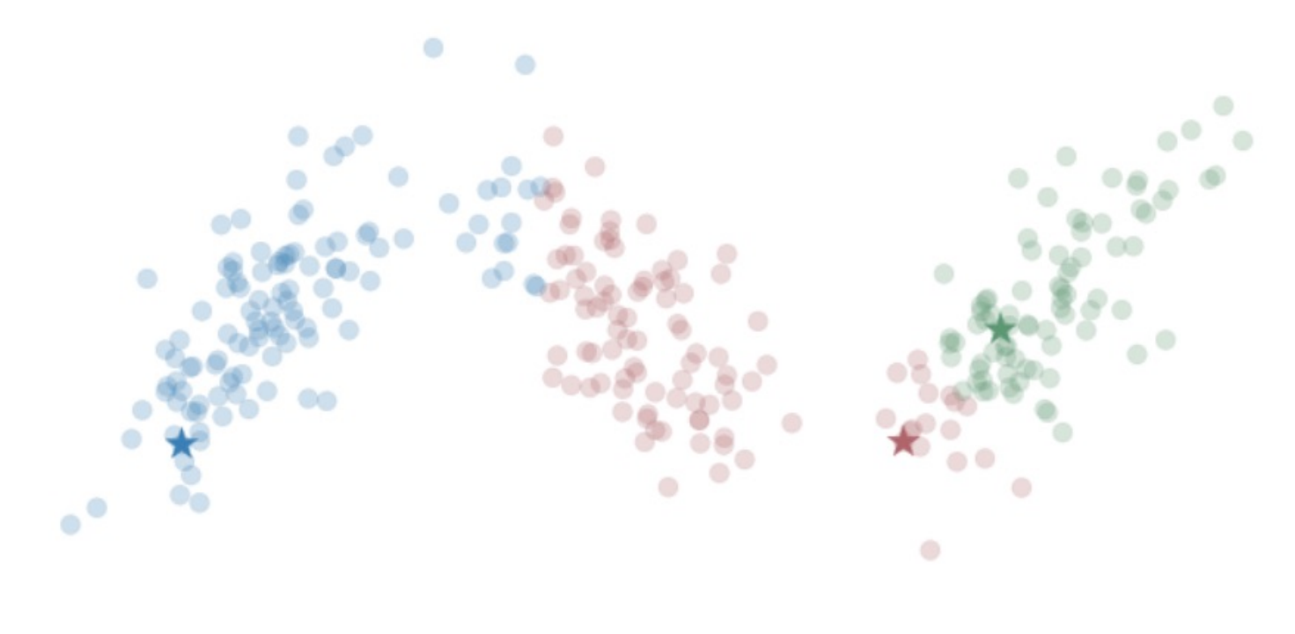

Clustering Objective - End

Slide 10
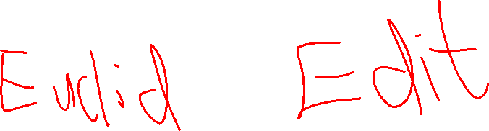
Clustering – Similarity Rules
Given a distance measure d(x,y)
Symmetry: d(x,y) = d(y,x)
Self Consistency: d(x,x) = 0
Positivity: d(x,y) = 0 if x = y
Triangle Inequality: d(x,y) <= d(x,z) + d(z,y)

Slide 12
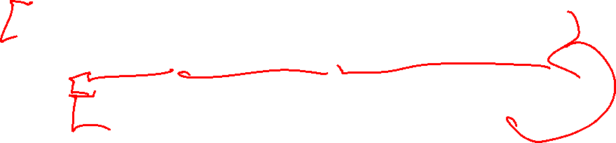
Clustering – K Means
Samples = matrix (of features X entries)
Cents = array of K random points (within min, max of each dimension)
While not max_iter, changed_points > 0, Cents – Old_cents > lamda:
Sample_cluster = array tracking nearest centroid (aka cluster)
Cents ← recompute based on Sample_cluster (keep old to loop)
Return sample_cluster, Cents

Slide 13

K Means
Given:
Centroids for multiple clusters
Compute Cluster Assignment for points
E.g. Euclidian distance
7
6
5
2
4
5
7

Slide 14

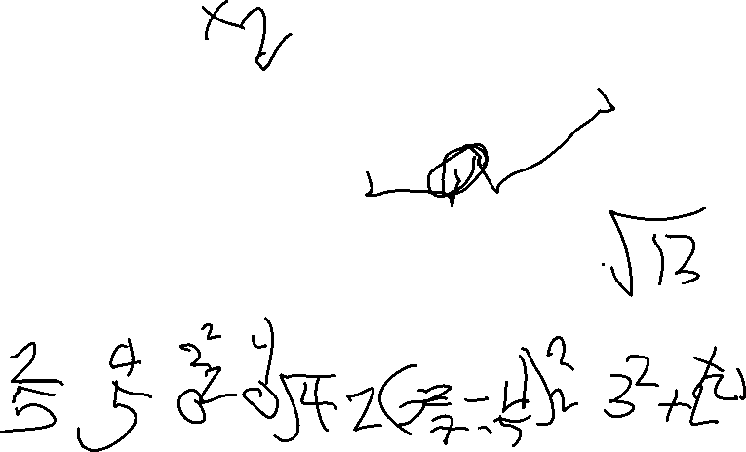
K Means
Given:
Centroids for multiple clusters
Compute Cluster Assignment for points
E.g. Euclidian distance
$$d=\sqrt{\sum{{(x_{i_{centroid}}−x_{i_{sample}})}^{2}}}$$
7
6
5
2
4
5
7

Slide 15
K Means
Given:
Centroids for multiple clusters
Compute Cluster Assignment for points
E.g. Euclidian distance
$$d=\sqrt{\sum{{(x_{i_{centroid}}−x_{i_{sample}})}^{2}}}$$
7
6
5
2
4
5
7

Slide 16
K Means
Given:
Cluster Assignment for Points
Compute Centroid
6
5
4
5

Slide 17

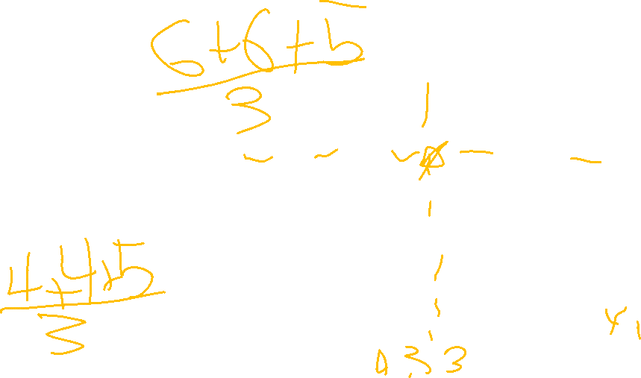
K Means
Given:
Cluster Assignment for Points
Compute Centroid
$${centroid}_{dimension_i}=avg(x_{i})$$
6
5
4
5

Slide 18

K Means – Sensitive to Initial Centroids
K Means can be easily thrown off by outliers or nonlinearities
Can converge to a variety of points
- Converging to Local Minimum
Fix?
Run several times (random initialization) and choose best
Choose Centroids that are well separated (K Means ++, see PS5)

Slide 19
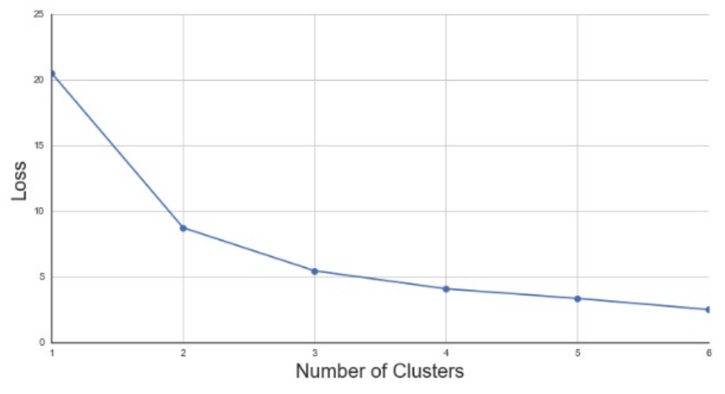
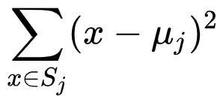
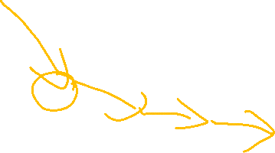
K Means - # Clusters
Elbow Method
- Choose the number of clusters with the most change in the derivative of the loss (i.e. choose the most bent elbow)
L2 Cost Function
Notes:
https://en.wikipedia.org/wiki/K-means_clustering

Slide 20
K Means – Categorical Data
Solution: Encode same or different / create one-hot vectors
Improvement: adjust distance based on how common an option is
- If 90% of your sample is non-smoking, being a smoking sample is more of an oddity, so perhaps it should differentiate a cluster
- K Means – adjust based on popularity for non-binary
- K Modes – simplify as binary, either most popular choice or not
https://shapeofdata.wordpress.com/2014/03/04/k-modes/

Slide 22
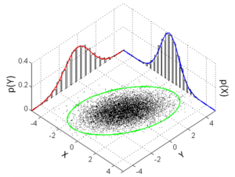
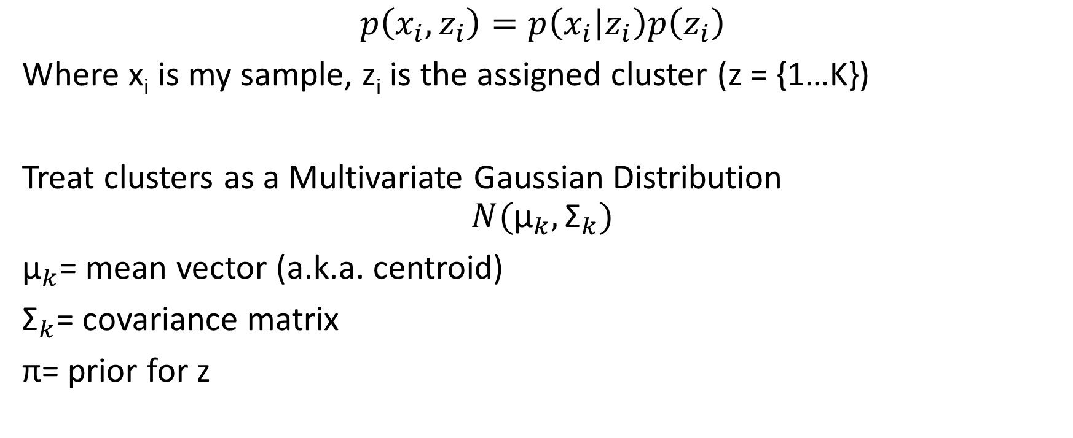
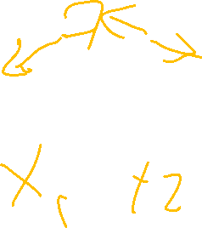
Generalizing K Means – Gaussian Distribution
$$p\left(x_{i},z_{i}\right)=p\left(x_{i} | z_{i}\right)p\left(z_{i}\right)$$
Where x_{i} is my sample, z_{i} is the assigned cluster (z = {1…K})
Treat clusters as a Multivariate Gaussian Distribution
$$N({\text{μ}}_{k},{\text{Σ}}_{k})$$
${\text{μ}}_{k}$= mean vector (a.k.a. centroid)
${\text{Σ}}_{k}$= covariance matrix
$\text{π}$= prior for z
Notes:
https://en.wikipedia.org/wiki/Multivariate_normal_distribution

Slide 23
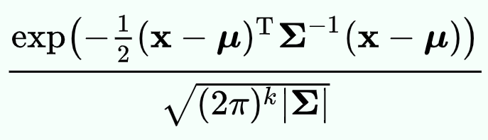
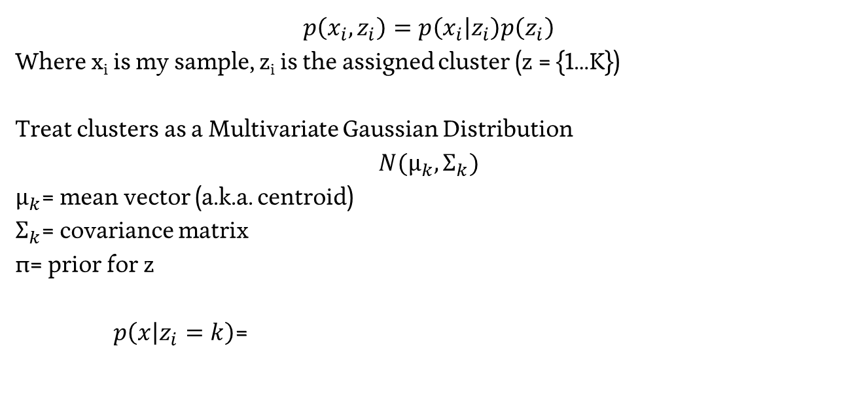
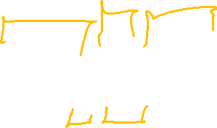
Generalizing K Means – Gaussian Distribution
$$p\left(x_{i},z_{i}\right)=p\left(x_{i} | z_{i}\right)p\left(z_{i}\right)$$
Where x_{i} is my sample, z_{i} is the assigned cluster (z = {1…K})
Treat clusters as a Multivariate Gaussian Distribution
$$N({\text{μ}}_{k},{\text{Σ}}_{k})$$
${\text{μ}}_{k}$= mean vector (a.k.a. centroid)
${\text{Σ}}_{k}$= covariance matrix
$\text{π}$= prior for z
$p\left(x | z_{i}=k\right)$=
Notes:
https://en.wikipedia.org/wiki/Multivariate_normal_distribution

Slide 24

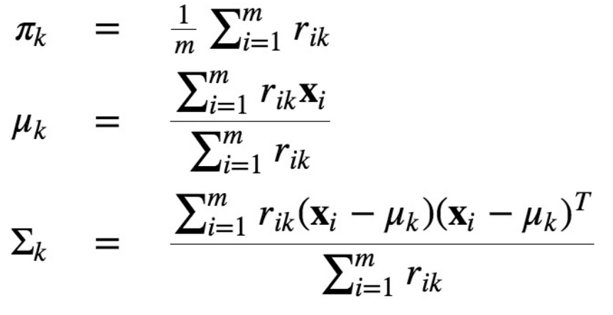
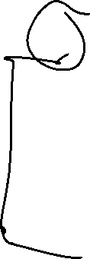
Gaussian Mixture Model – Expectation Maximization
Hold Z fixed, maximize our variables

Slide 25
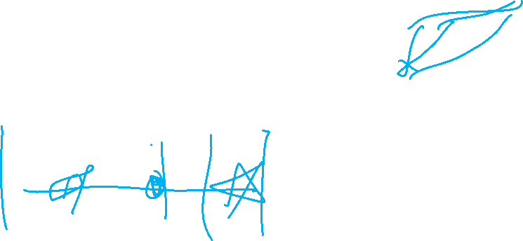
Given:
Centroids, Covariance, Priors for multiple clusters
Compute Cluster Assignment for points (max probability)

Slide 26
Generalizing K Means – Gaussian Distribution
$$p\left(x_{i},z_{i}\right)=p\left(x_{i} | z_{i}\right)p\left(z_{i}\right)$$
Where x_{i} is my sample, z_{i} is the assigned cluster (z = {1…K})
Treat clusters as a Multivariate Gaussian Distribution
$$N({\text{μ}}_{k},{\text{Σ}}_{k})$$
${\text{μ}}_{k}$= mean vector (a.k.a. centroid)
${\text{Σ}}_{k}$= covariance matrix
$\text{π}$= prior for z
$p\left(x | z_{i}=k\right)$=
Notes:
https://en.wikipedia.org/wiki/Multivariate_normal_distribution

Slide 27
Given:
Centroids, Covariance, Priors for multiple clusters
Compute Cluster Assignment for points (max probability)
*Compute easily calculatable portions of the probability

Slide 28

Given:
Cluster Assignment for points
Compute Centroid, Covariance, Prior for clusters

Slide 30
Basic Feed-Forward Neural Networks
1
1
b¹
b²
Every element of a layer is connected to every element of the following layer
Ordering, neighboring doesn’t matter…
Y₁
X₁
Y₂
X₂
W¹
W²

Slide 31
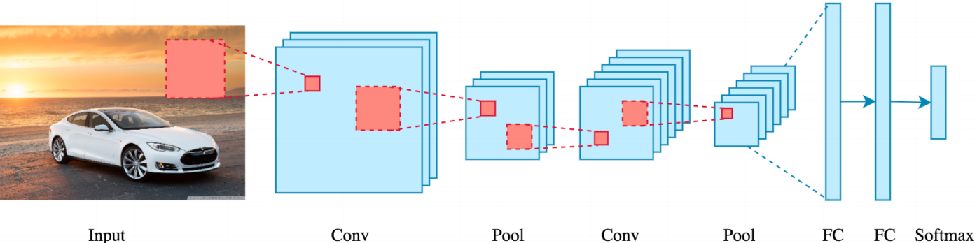
Convolution + Pooling

Slide 32
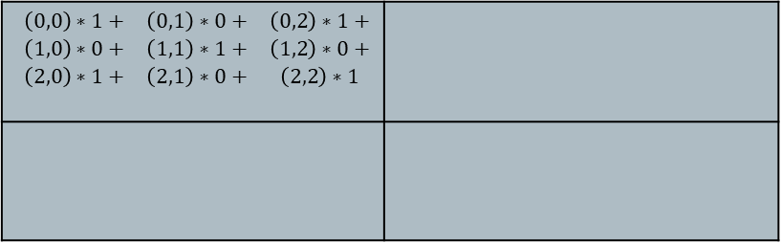
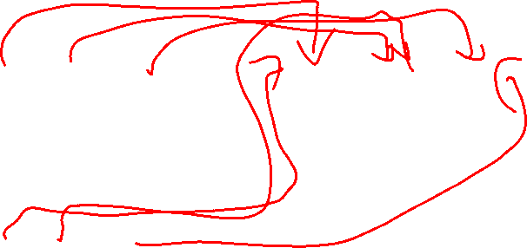
Convolution
Initial Matrix Output Matrix
Convolution Matrix
20 | 20 | 45 | 200
18 | 20 | 125 | 240
35 | 125 | 245 | 245
145 | 250 | 240 | 240
$$\begin{matrix}\left(0,0\right)∗1+ & \left(0,1\right)∗0+ & \left(0,2\right)∗1+ \\ \left(1,0\right)∗0+ & \left(1,1\right)∗1+ & \left(1,2\right)∗0+ \\ \left(2,0\right)∗1+ & \left(2,1\right)∗0+ & \left(2,2\right)∗1\end{matrix}$$
1 | 0 | 1
0 | 1 | 0
1 | 0 | 1

Slide 33
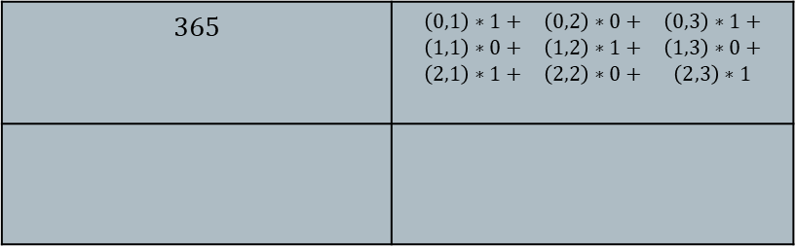
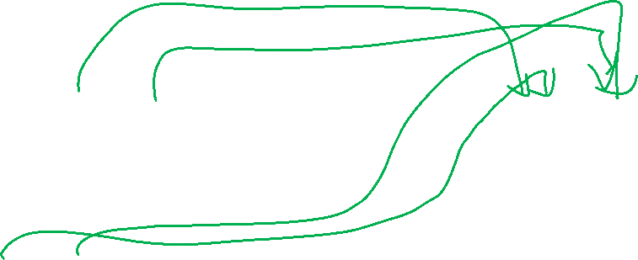
Convolution
Initial Matrix Output Matrix
Convolution Matrix
20 | 20 | 45 | 200
18 | 20 | 125 | 240
35 | 125 | 245 | 245
145 | 250 | 240 | 240
$$365$$ | $$\begin{matrix}\left(0,1\right)∗1+ & \left(0,2\right)∗0+ & \left(0,3\right)∗1+ \\ \left(1,1\right)∗0+ & \left(1,2\right)∗1+ & \left(1,3\right)∗0+ \\ \left(2,1\right)∗1+ & \left(2,2\right)∗0+ & \left(2,3\right)∗1\end{matrix}$$
1 | 0 | 1
0 | 1 | 0
1 | 0 | 1

Slide 34
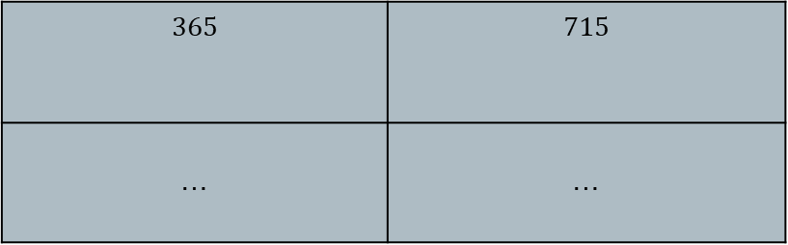
Convolution
Initial Matrix Output Matrix
Convolution Matrix
20 | 20 | 45 | 200
18 | 20 | 125 | 240
35 | 125 | 245 | 245
145 | 250 | 240 | 240
$$365$$ | $$715$$
… | …
1 | 0 | 1
0 | 1 | 0
1 | 0 | 1

Slide 35
Convolution + Pooling

Slide 36
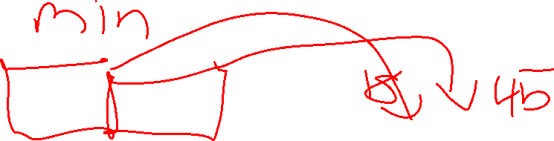
Pooling
Reduce Complexity by combining neighboring terms
e.g. max pool
20 | 20 | 45 | 200
18 | 20 | 125 | 240
35 | 125 | 245 | 245
145 | 250 | 240 | 240
20 | 240
250 | 245

Slide 37

Convolution + Pooling

Slide 38
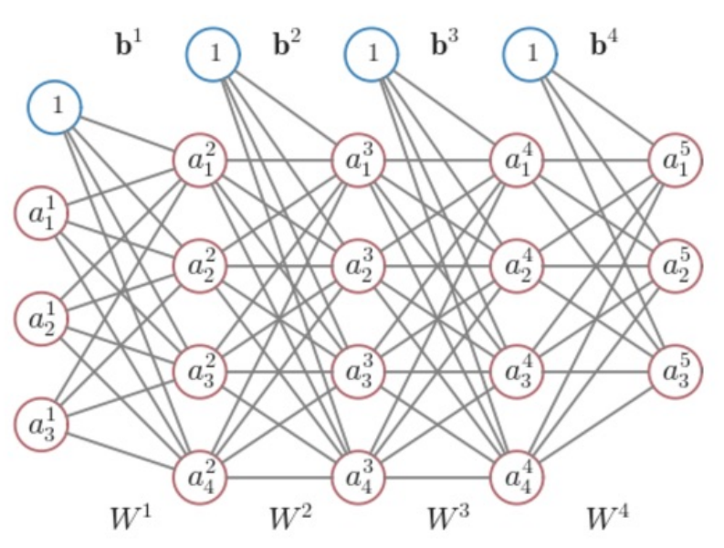

Neural Networks - Notation
$$l=layer (from 1 to L)$$
$$b^{l}=vector of bias inputs for l+1$$
$$b_{i}^{l}=bias value, layer l, node i$$
$$W^{l}=matrix of weights for l+1$$
$$w_{ij}^{l}=weigh value, layer l, nodes j to i$$

Slide 39
Improving Convolutions
SGD with Back Propagation
Details of implementation are beyond this course

Slide 41
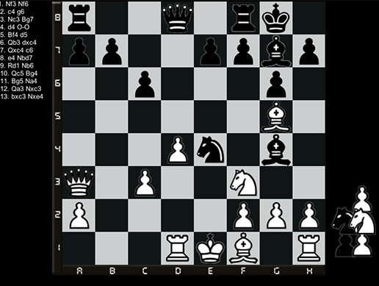

Defining Our Problem Space
Agent – A decision-making entity
Environment – The space in which the Agent is making decisions
State (S) – The current status of the Environment
Goal – An eventual outcome sought by the Agent
Reward (R) – Intermediate measure of success/failure towards the Goal
Action (A) – The options available to the Agent to change the State

Slide 42
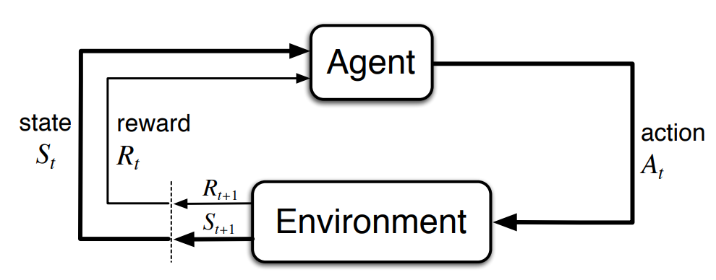

Markov Decision Processes
Notes:
http://incompleteideas.net/book/bookdraft2017nov5.pdf

Slide 43
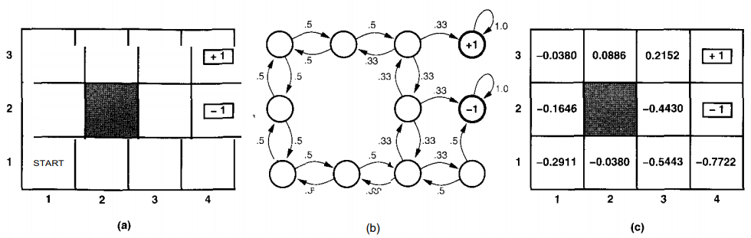
Developing Q – Updating Value
Calculate out the probability of success or failure at each point
Notes:
https://www.cin.ufpe.br/~tfl2/artificial-intelligence-modern-approach.9780131038059.25368.pdf

Slide 44
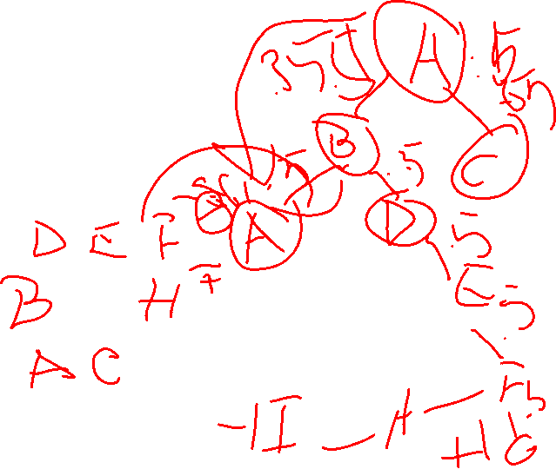
Developing Q – Updating Value
Calculate out the probability of success or failure at each point
Notes:
https://www.cin.ufpe.br/~tfl2/artificial-intelligence-modern-approach.9780131038059.25368.pdf

Slide 45
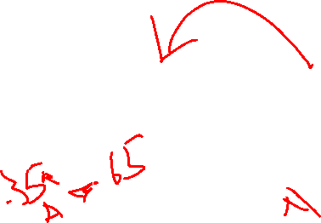
Developing Q – Updating Policy
You can use this approach to feed back into your decision policies!
Notes:
https://www.cin.ufpe.br/~tfl2/artificial-intelligence-modern-approach.9780131038059.25368.pdf

Slide 46
Scale – Monte Carlo Estimation
Instead of mapping out the full probability space, let’s generate a bunch of sample uses of our policy (to end-state) and use the outcomes to determine value!
Notes:
https://thumbs.gfycat.com/BetterThankfulEnglishsetter-max-1mb.gif

Slide 47


Slide 48
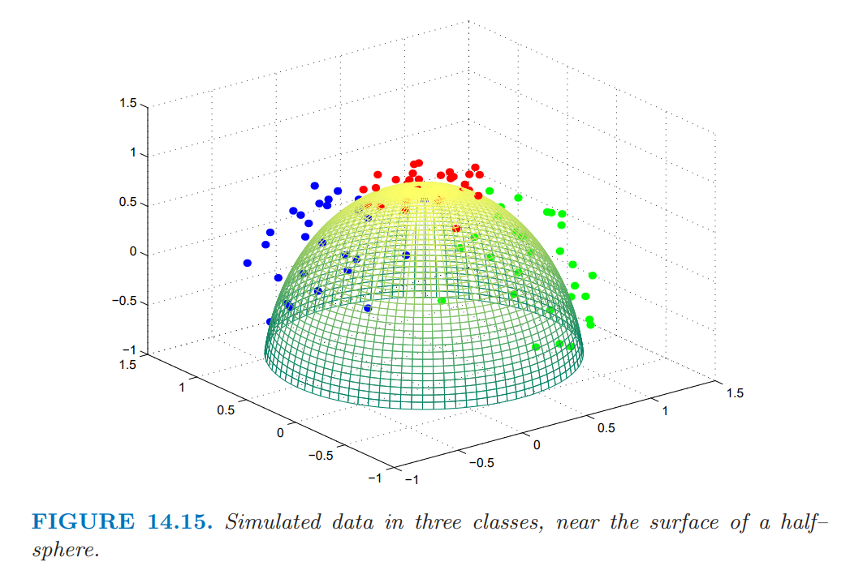
Principal Components – A different objective
What is unique?
What makes an X?

Slide 49
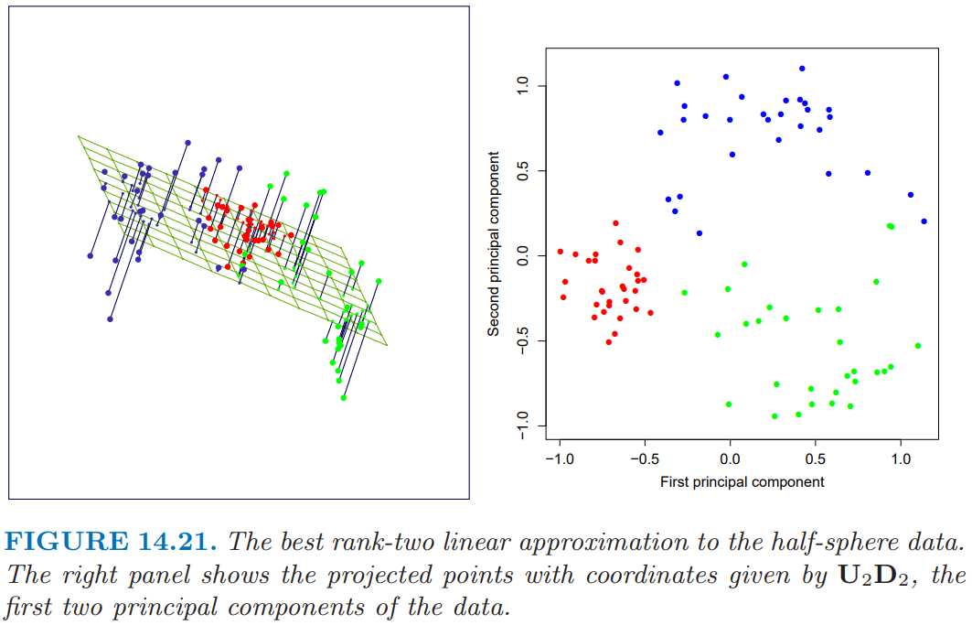
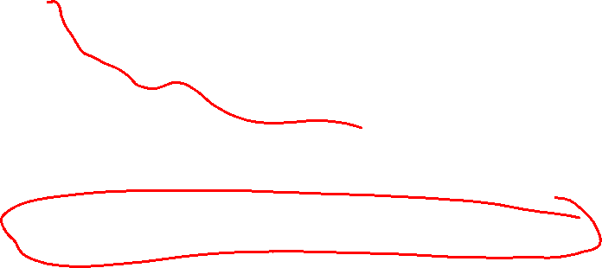
Step 1 – Build a Linear Model Approximation
Implementation details are outlined in ESL Textbook

Slide 50

Step 1 – Build a Linear Model Approximation
Implementation details are outlined in ESL Textbook

Slide 51
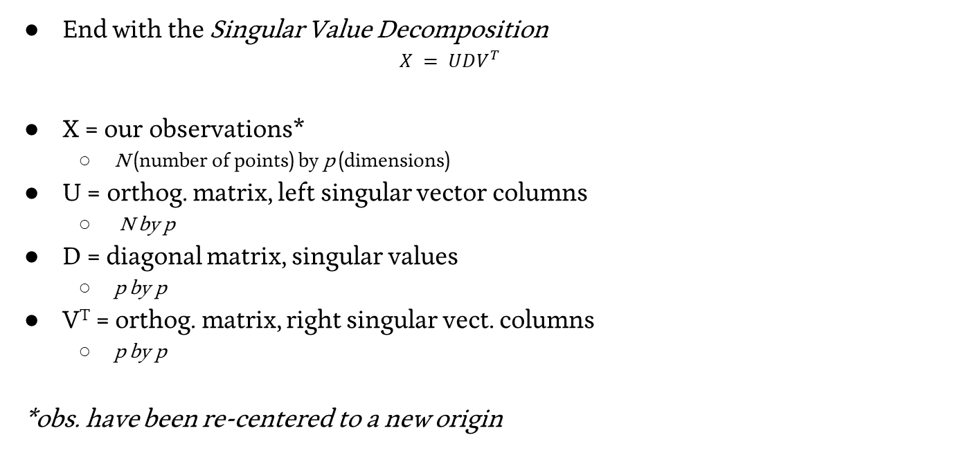
Step 1 – Build a Linear Model Approximation
End with the Singular Value Decomposition
$$X = UDV^{T}$$
X = our observations*
N (number of points) by p (dimensions)
U = orthog. matrix, left singular vector columns
N by p
D = diagonal matrix, singular values
p by p
V^{T} = orthog. matrix, right singular vect. columns
p by p
*obs. have been re-centered to a new origin

Slide 52


Step 2 – Extract the q principal components you seek
$X_{q} = U_{q}D_{q}$

Slide 53
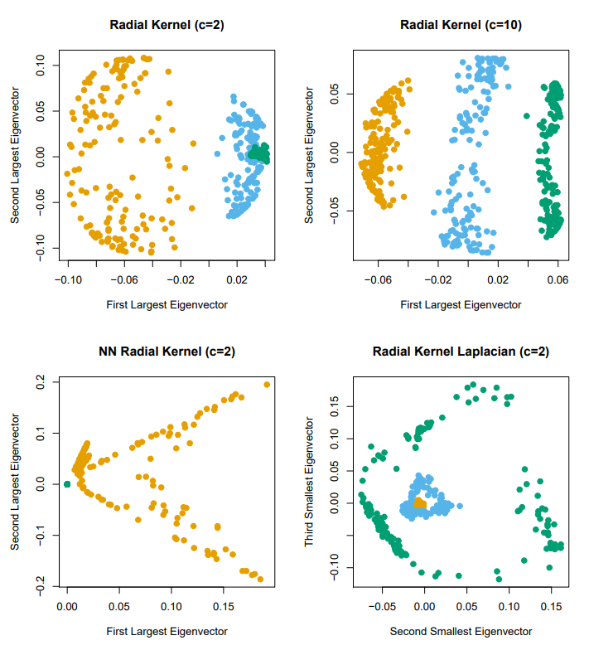
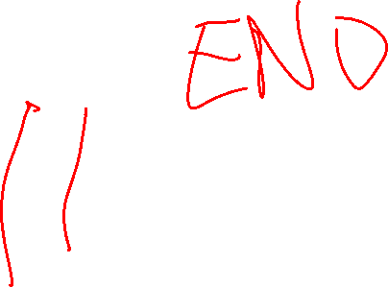
Kernel PCA

